Slide 1

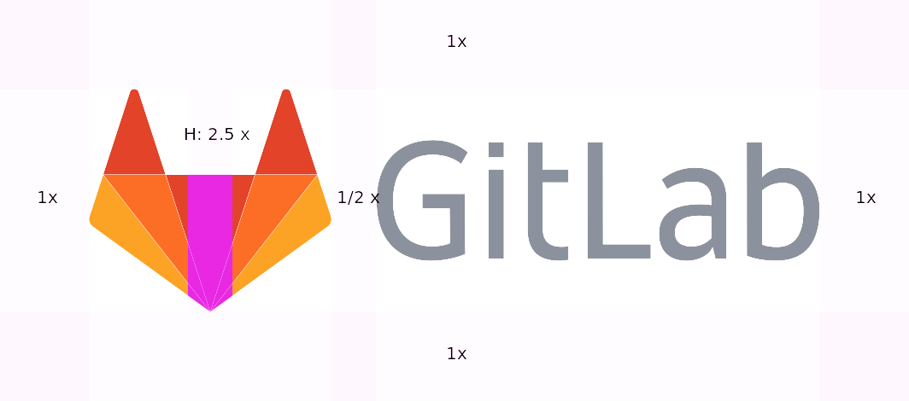
Postcard
Compare the past with the present
Usage
Select photo, ideally with geolocation data
Configure overlay containing the photo
Use overlay to align with the subject in Camera app
Required Permissions
See Privacy Policy for explanation of permissions and analytics
FILES AND MEDIA...
LOCATION...
DISPLAY OVER OTHER APPS...
SELECT PHOTO
1234abcd/1.0.0-googleplay

Slide 2

Select photo
Source
Key
Tap to Configure overlay
STORAGE ACCESS FRAMEWORK...
Approx distance (if geolocation data available)
Launch navigation App (if installed on device)
Google Photos
Library
Start...
End...
Category
5m
25km

Slide 3
Configure overlay
Window
Preview
Border & button colour
. use header to move overlay
. pinch and zoom supported
Width
Height
Photo
Transparency %
Edge Detection
Blur
Thresholds
DISPLAY OVERLAY

Slide 5
Horizontel and vertial layouts
Have as a share receiver – i.e. share an image into postcard “Configure Overlay” activity
Emphasise privacy policy
- no GPS / Photographic / Overlay / Personal information kept in analytics
Have bg localisation
Google Photo’s integration is release 2.0.0

